Slide 1
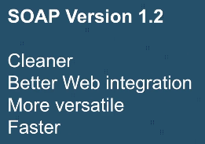
Difference between SOAP v1.1 and SOAP v1.2

Slide 2
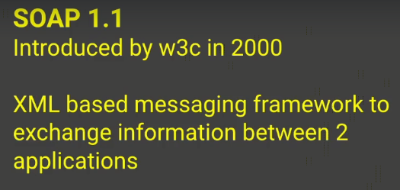
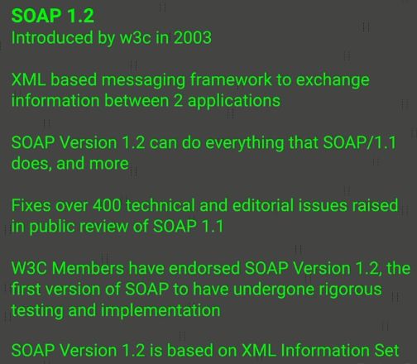
Difference between SOAP v1.1 and SOAP v1.2

Slide 3
Difference between SOAP v1.1 and SOAP v1.2
https://www.w3.org/2003/06/soap12-pressrelease
https://www.w3.org/2000/xp/Group/2/03/soap1.2implementation.html
https://www.w3.org/2003/06/soap11-soap12.html

